Slide 1
Data Analytics Classification and Regression Trees

Slide 2
ftable
tabl=ftable(Survived,Sex,Age,Class)
> tabl
 |  |  | Class 1st | 2nd | 3rd | Crew
Survived | Sex | Age
No | Female | Adult | 4 | 13 | 89 | 3
 |  | Child | 0 | 0 | 17 | 0
 | Male | Adult | 118 | 154 | 387 | 670
 |  | Child | 0 | 0 | 35 | 0
Yes | Female | Adult | 140 | 80 | 76 | 20
 |  | Child | 1 | 13 | 14 | 0
 | Male | Adult | 57 | 14 | 75 | 192
 |  | Child | 5 | 11 | 13 | 0

Slide 3
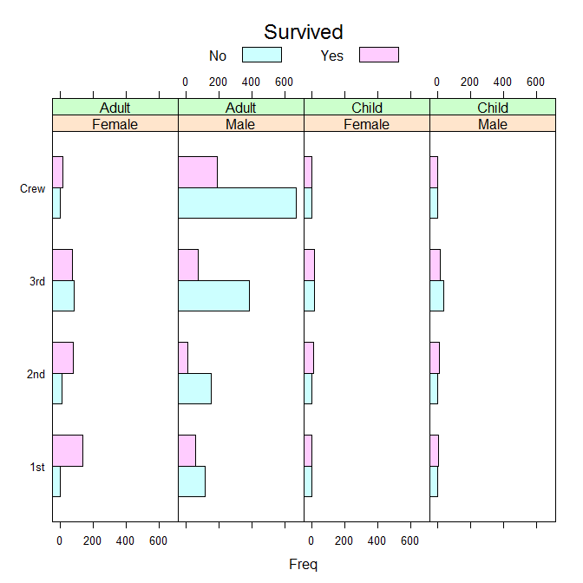

Slide 4
rpart output
n= 2201
node), split, n, loss, yval, (yprob)
* denotes terminal node
1) root 2201 711 No (0.6769650 0.3230350)
2) Sex=Male 1731 367 No (0.7879838 0.2120162)
4) Age=Adult 1667 338 No (0.7972406 0.2027594) *
5) Age=Child 64 29 No (0.5468750 0.4531250)
10) Class=3rd 48 13 No (0.7291667 0.2708333) *
11) Class=1st,2nd 16 0 Yes (0.0000000 1.0000000) *
3) Sex=Female 470 126 Yes (0.2680851 0.7319149)
6) Class=3rd 196 90 No (0.5408163 0.4591837) *
7) Class=1st,2nd,Crew 274 20 Yes (0.0729927 0.9270073) *
>

Slide 5
rpart output
CP nsplit rel error xerror xstd
1 0.30661041 0 1.0000000 1.0000000 0.03085662
2 0.02250352 1 0.6933896 0.6933896 0.02750982
3 0.01125176 2 0.6708861 0.6891702 0.02745007
4 0.01000000 4 0.6483826 0.6596343 0.02701971
Variable importance
Sex Class Age
73 23 4

Slide 6
Another example
 | CP | nsplit | rel error | xerror | xstd
1 | 0.08902692 | 0 | 1 | 1 | 0.04207569
2 | 0.08488613 | 1 | 0.910973 | 0.9689441 | 0.04152603
3 | 0.00345066 | 2 | 0.826087 | 0.8322981 | 0.03892747
4 | 0.00325348 | 5 | 0.815735 | 0.8799172 | 0.03986822
5 | 0.00207039 | 19 | 0.763975 | 0.8861284 | 0.03998804
6 | 0.00165632 | 32 | 0.73706 | 0.931677 | 0.04084734
7 | 0.0010352 | 41 | 0.716356 | 0.9358178 | 0.04092381
8 | 0.001 | 43 | 0.714286 | 0.9585921 | 0.04133964

Slide 7
More output
Node number 1: 2201 observations, complexity param=0.3066104
predicted class=No expected loss=0.323035 P(node)=1
class counts: 1490 711
probabilities: 0.677 0.323
left son=2 (1731 obs) right son=3 (470 obs)
Primary splits:
Sex splits as RL, improve=199.821600, (0 missing)
Class splits as RRLL, improve= 69.684100, (0 missing)
Age splits as LR, improve= 9.165241, (0 missing)

Slide 8
And yet another node
Node number 2: 1731 observations, complexity param=0.01125176
predicted class=No expected loss=0.2120162 P(node) =0.7864607
class counts: 1364 367
probabilities: 0.788 0.212
left son=4 (1667 obs) right son=5 (64 obs)
Primary splits:
Age splits as LR, improve=7.726764, (0 missing)
Class splits as RLLL, improve=7.046106, (0 missing)

Slide 9
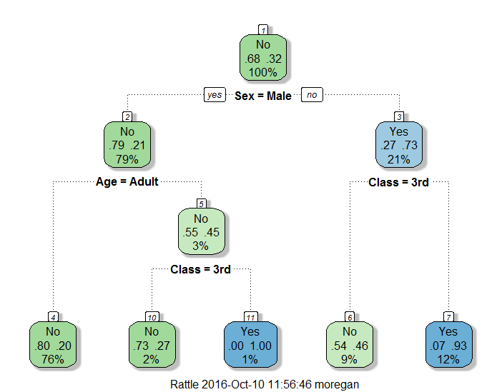
Tree from titanic

Slide 10
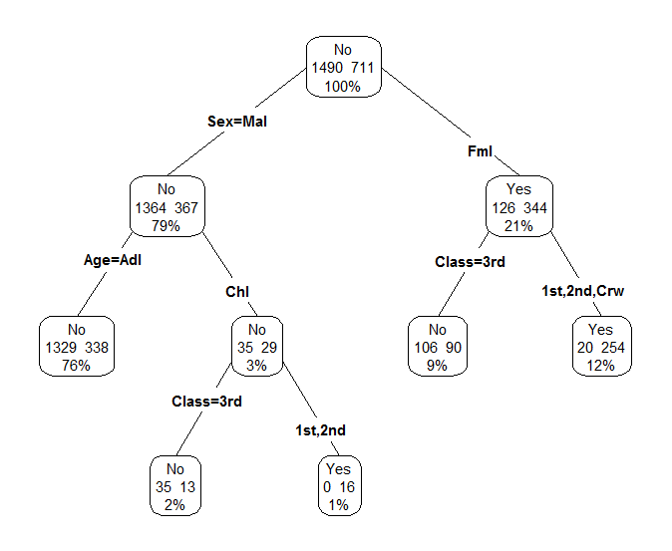
rpart.plot

Slide 11
rpart
fittit<-rpart(Survived ~ Class + Age + Gender)
table(fittit$where)
3 5 6 8 9
1667 48 16 196 274

Slide 12
rpart output
 |  | Survived
Sex |  | No | Yes
 | Female | 126 | 344 | 470
 | Male | 1364 | 367 | 1731
 |  | 1490 | 711
Female: P(no|female) = 126/470= .27 P(yes |female)=.73
Male: P(no|Male) = 1364/1731= .78 P(yes |Male)=.22

Slide 13
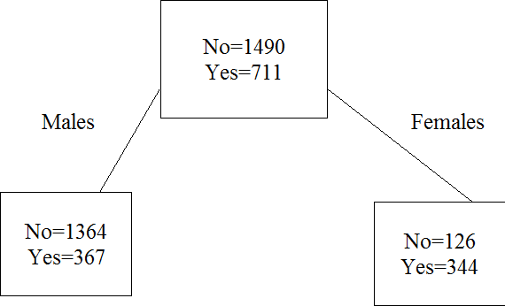
Root node
Node =2
Node =3
Calculating node impurity
i(root node)=2*0.677*0.323=0.437; i(node 2)=2*0.788*0.212=0.334
i(node 3) = 2*0.268*0.732=0.392; p(R) = 470/2201=0.214; p(L)=1731/2201=0.786

Slide 14
Calculations for impurity
Impurity of root node 1 | 0.437
impurity of node 2 | 0.334
impurity of node 3 | 0.392
p(Root node) | 1.000
p(node 2)= p(L) | 0.786
p(node 3)=p(R) | 0.214
Decrease in impurity (∆(t,s) in notes) = 0.437-0.786*0.334-0.214*0.392=0.0906
R - Improvement= 0.0906*2201 = 199.35 ( slight rounding here)
All calculations assuming data as priors.

Slide 15
Calculations for cp
R(Root node) | 0.323
r(1) | 0.212
r(2) | 0.268
R(1) | 0.167
R(2) | 0.057
R(tree) | 0.224
cp | 0.099
cp according to R | 0.307

Slide 16
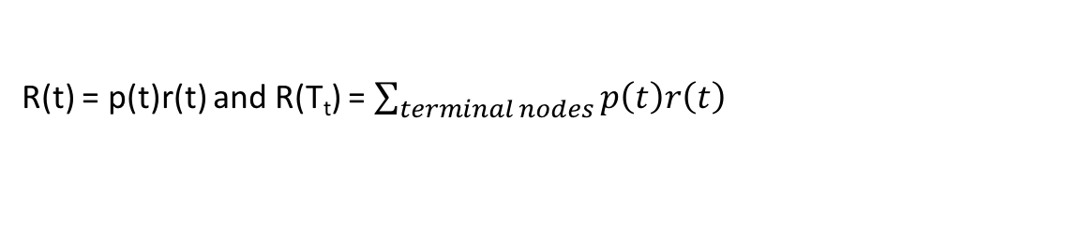
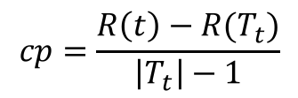
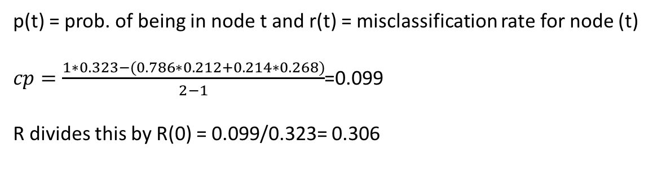
Calculation of cp
$$cp=\frac{R\left(t\right)−R(T_{t})}{\left|T_{t}\right|−1}$$
where t refers to root node and T_{t} is the 2 node tree
R(t) = p(t)r(t) and R(T_{t}) = $\sum_{terminal nodes}{p\left(t\right)r\left(t\right)}$
p(t) = prob. of being in node t and r(t) = misclassification rate for node (t)
$cp=\frac{1∗0.323−(0.786∗0.212+0.214∗0.268)}{2−1}$=0.099
R divides this by R(0) = 0.099/0.323= 0.306

Slide 17
R-code for barchart
library(lattice)
Freq=xtabs(~Class+Sex+Age+Survived,data)
tdata=as.data.frame(Freq)
barchart(Class~Freq | Sex+Age,data=tdata,groups=Survived,layout=c(4,1),
auto.key=list(title="Survived", columns=2))

Slide 18
More R-code
Instead of attaching a dataset use the ‘with’ command
mytable<-with(TITANIC,table(Survived,Gender))
To get proportions for a table (just one way to do it)
prop.table(mytable)
prop.table(mytable,1) – row proportions
prop.table(mytable,2) – column proportions

